Slide 1
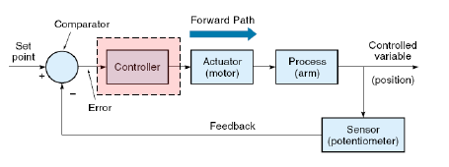
Process modeling & Controller design
Instrumentation
Navid Alaei Sheini
Assistance Professor
Shahid Chamran University of Ahvaz
اردیبهشت 1404

Slide 2
فهرست مطالب:
اجزا اصلی سیستم کنترل
مدلسازی فرآیند
  استاتیکی
  دینامیکی
پاسخ پله (مرسوم ترین)
مدلسازی فرایند با پاسخ به پله
  دو پارامتری
  سه پارامتری
طراحی کنترولر

Slide 3
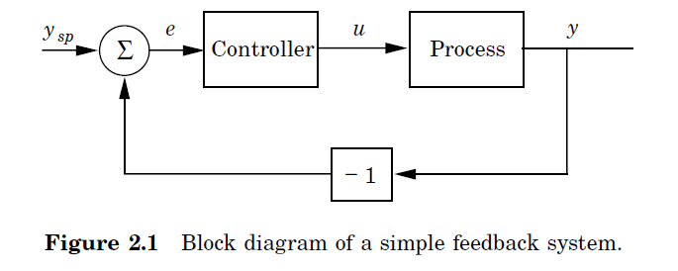
بلوک دیاگرام سیستم کنترلی
The system has two major components, the process and the controller.The process has one input, the manipulated variable (control variable) denoted by u. The process output is called process variable (PV) denoted by y. This variable is measured by a sensor. The desired value of the process variable is called the setpoint (SP) or the reference value (y_{sp}). The control error e is the difference between the setpoint and the process variable, i.e., e = y_{sp} − y. The controller in Figure has one input, the error, and one output, the control variable. The figure shows that the process and the controller are connected in a closed feedback loop.
Åström, Karl Johan, and Tore Hägglund. PID controllers: theory, design, and tuning. Vol. 2. Research Triangle Park, NC: Instrument society of America, 1995.

Slide 4
مدلسازی فرآیند
مدل سازی استاتیکی
The static process characteristic is a curve that gives the steady state relation between process input signal u and process output y. Notice that the curve has a physical interpretation only for a stable process.
Åström, Karl Johan, and Tore Hägglund. PID controllers: theory, design, and tuning. Vol. 2. Research Triangle Park, NC: Instrument society of America, 1995.

Slide 5
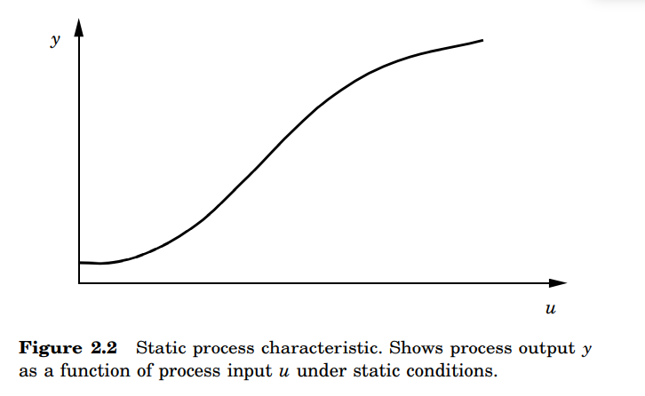
مدلسازی فرآیند- مدل سازی استاتیکی
کاربرد مدل سازی استاتیکی
All process investigations should start by a determination of the static process model. It can be used to determine the range of control signals required to change the process output over the desired range, to size actuators, and to select sensor resolution. It can also be used to assess whether static gain variations are so large that they have to be accounted for in the control design.
Åström, Karl Johan, and Tore Hägglund. PID controllers: theory, design, and tuning. Vol. 2. Research Triangle Park, NC: Instrument society of America, 1995.

Slide 6
مدلسازی فرآیند- مدل سازی استاتیکی
روش بدست آوردن مدل استاتیکی:
The static model can be obtained in several ways. It can be determined by an open-loop experiment where the input signal is set to a constant value and the process output is measured when it has reached steady state. This gives one point on the process characteristics. The experiment is then repeated to cover the full range of inputs.
An alternative procedure is to make a closed-loop experiment. The setpoint is then given a constant value and the corresponding control variable is measured in steady state. The experiment is then repeated to cover the full range of setpoints.
The experiments required to determine the static process model often give a good feel for how easy it is to control the process, if it is stable, and if there are many disturbances.
Sometimes process operations do not permit the experiments to be done as described above. Small perturbations are normally permitted, but it may not be possible to move the process over the full operating range. In such a case the experiment must be done over a long period of time.
Åström, Karl Johan, and Tore Hägglund. PID controllers: theory, design, and tuning. Vol. 2. Research Triangle Park, NC: Instrument society of America, 1995.

Slide 7
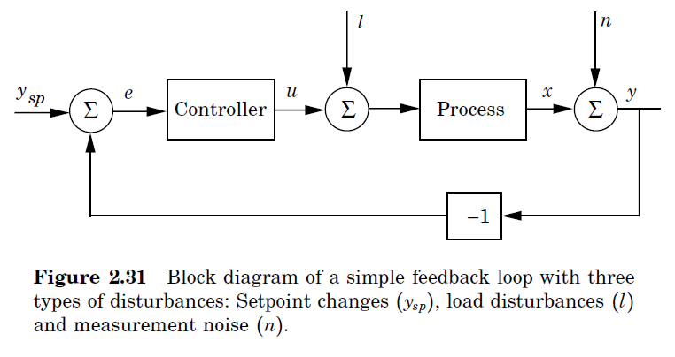
بلوک دیاگرام کنترل حلقه بسته- نویز و اغتشاش بار
Åström, Karl Johan, and Tore Hägglund. PID controllers: theory, design, and tuning. Vol. 2. Research Triangle Park, NC: Instrument society of America, 1995.

Slide 8
بلوک دیاگرام کنترل حلقه بسته- نویز و اغتشاش بار
روش اندازه گیری اغتشاش:
Process disturbances are easily determined by logging the process output when the control signal is constant. Such a measurement will give a combination of measurement and load disturbances. There are many sophisticated techniques such as time-series analysis and spectral analysis that can be used to determine the characteristics of the process noise. Crude estimates of the noise characteristics are obtained simply by measuring the peak-to-peak value.
Åström, Karl Johan, and Tore Hägglund. PID controllers: theory, design, and tuning. Vol. 2. Research Triangle Park, NC: Instrument society of America, 1995.

Slide 9
مدلسازی فرآیند- مدل سازی دینامیکی
1- پاسخدهی گذرا
In transient response analysis the system dynamics are characterized in terms of the response to a simple signal. The particular signal is often chosen so that it is easy to generate experimentally. Typical examples are steps, pulses, and impulses.
Åström, Karl Johan, and Tore Hägglund. PID controllers: theory, design, and tuning. Vol. 2. Research Triangle Park, NC: Instrument society of America, 1995.

Slide 10
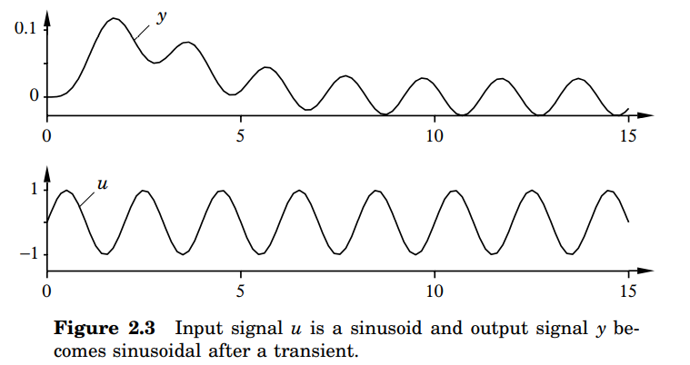
مدلسازی فرآیند- مدل سازی دینامیکی
2- پاسخدهی فرکانسی
Another way to characterize the dynamics of a linear time-invariant system is to use sine waves as a test signal. This idea goes back to Fourier. The idea is that the dynamics can be characterized by investigating how sine waves propagate through a system.
Åström, Karl Johan, and Tore Hägglund. PID controllers: theory, design, and tuning. Vol. 2. Research Triangle Park, NC: Instrument society of America, 1995.

Slide 11
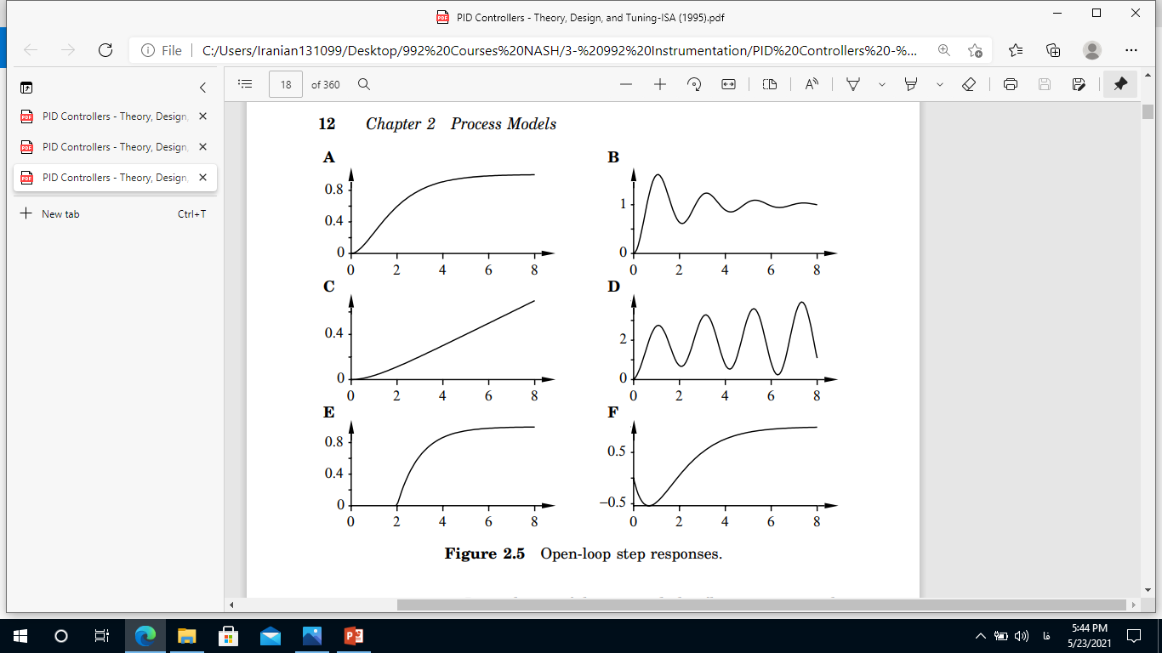
مدلسازی فرآیند- پاسخ پله
پاسخ مدار باز پله (حالتهای A تا F) :
The systems in A and B are stable, whereas the systems shown in C and D are unstable. The system in C shows the output of an integrating process.
Åström, Karl Johan, and Tore Hägglund. PID controllers: theory, design, and tuning. Vol. 2. Research Triangle Park, NC: Instrument society of America, 1995.

Slide 12
مدلسازی فرآیند- پاسخ پله
پاسخ مدار باز پله:
The system in Figure E has a long dead time. The dead time occurs when there are transportation delays in the process. The system in Figure F is a non-minimum phase system, where the measurement signal initially moves in the “wrong” direction. The water level in boilers often reacts like this after a step change in feed water flow.
Åström, Karl Johan, and Tore Hägglund. PID controllers: theory, design, and tuning. Vol. 2. Research Triangle Park, NC: Instrument society of America, 1995.

Slide 13
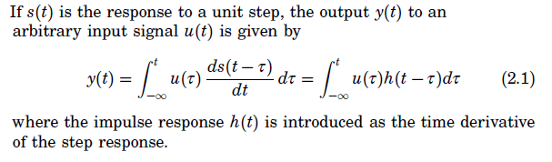
مدلسازی فرآیند- پاسخ پله
اهمیت پاسخ پله و پاسخ ضربه در مدلسازی فرآیند در سیستمهای LTI:
In process control, the step response is the most common transient used for process identification.
Åström, Karl Johan, and Tore Hägglund. PID controllers: theory, design, and tuning. Vol. 2. Research Triangle Park, NC: Instrument society of America, 1995.

Slide 14
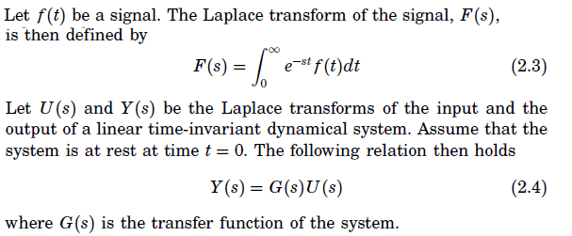

مدل سازی فرآیند
مدلسازی فرآیند در حوزه لاپلاس:
Åström, Karl Johan, and Tore Hägglund. PID controllers: theory, design, and tuning. Vol. 2. Research Triangle Park, NC: Instrument society of America, 1995.

Slide 15

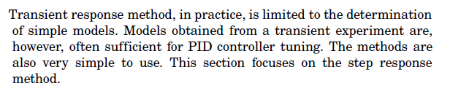
مدل سازی فرآیند
پاسخ دینامیکی فرآیند:
Åström, Karl Johan, and Tore Hägglund. PID controllers: theory, design, and tuning. Vol. 2. Research Triangle Park, NC: Instrument society of America, 1995.

Slide 16
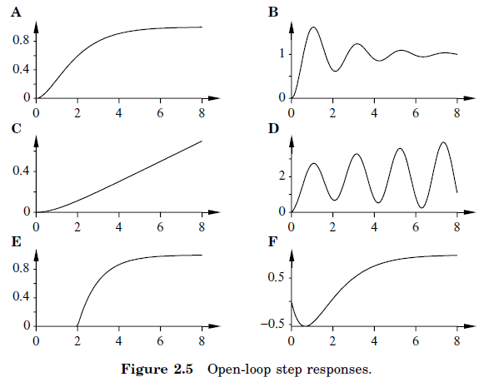
مدل سازی فرآیند
مثالهایی پاسخ پله فرآیند:
Åström, Karl Johan, and Tore Hägglund. PID controllers: theory, design, and tuning. Vol. 2. Research Triangle Park, NC: Instrument society of America, 1995.

Slide 17
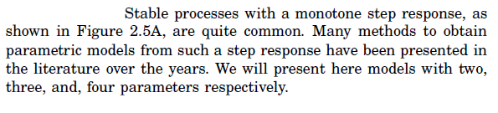
مدل سازی فرآیند
بررسی پاسخ پله فرآیند در متداول ترین حالت:
Åström, Karl Johan, and Tore Hägglund. PID controllers: theory, design, and tuning. Vol. 2. Research Triangle Park, NC: Instrument society of America, 1995.

Slide 18

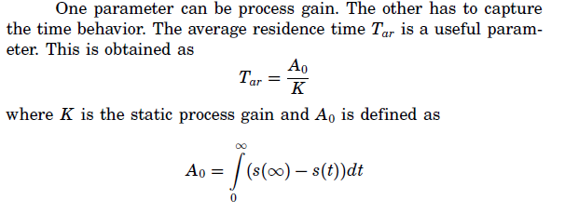
مدل سازی فرآیند- در متداول ترین حالات:
مدل سازی دو پارامتری- حال اول:
Åström, Karl Johan, and Tore Hägglund. PID controllers: theory, design, and tuning. Vol. 2. Research Triangle Park, NC: Instrument society of America, 1995.

Slide 19
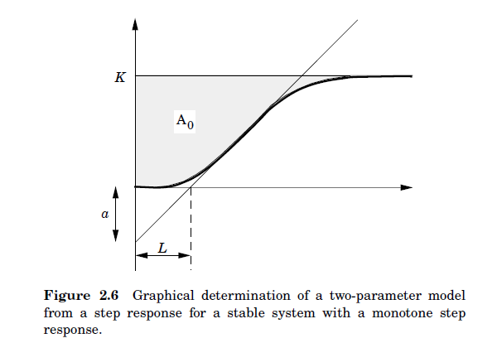
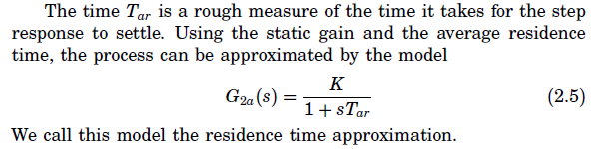
مدل سازی فرآیند- در متداول ترین حالات:
Åström, Karl Johan, and Tore Hägglund. PID controllers: theory, design, and tuning. Vol. 2. Research Triangle Park, NC: Instrument society of America, 1995.

Slide 20
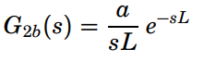
مدل سازی فرآیند- در متداول ترین حالات:
مدل سازی دو پارامتری- حال دوم:
Another approximation to the step response that also has two parameters is given by the transfer function:
This model corresponds to an integrator with dead time. This model is characterized by the two parameters, a and L, that are easily determined graphically from the step response
Åström, Karl Johan, and Tore Hägglund. PID controllers: theory, design, and tuning. Vol. 2. Research Triangle Park, NC: Instrument society of America, 1995.

Slide 21
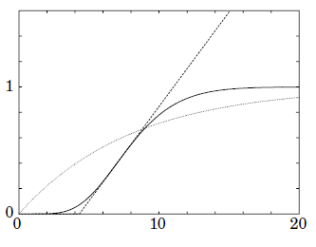
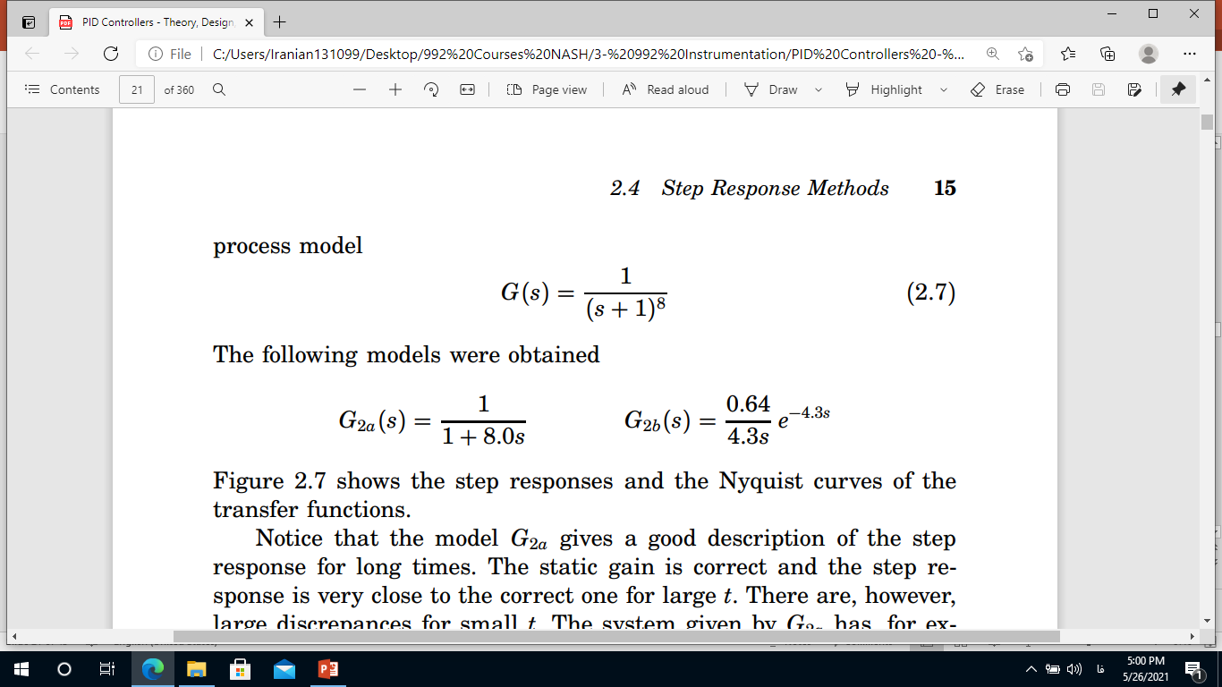

مدل سازی فرآیند- بررسی پاسخ پله فرآیند در متداول ترین حالت:
مثال:
Åström, Karl Johan, and Tore Hägglund. PID controllers: theory, design, and tuning. Vol. 2. Research Triangle Park, NC: Instrument society of America, 1995.

Slide 22

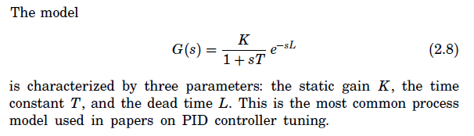
مدل سازی فرآیند- در متداول ترین حالات:
مدل سازی سه پارامتری:
Better approximations are obtained by increasing the number of parameters. The model:
This model is characterized by three parameters: the static gain K, the time constant T, and the dead time L. This is the most common process model used in papers on PID controller tuning.
Åström, Karl Johan, and Tore Hägglund. PID controllers: theory, design, and tuning. Vol. 2. Research Triangle Park, NC: Instrument society of America, 1995.

Slide 23
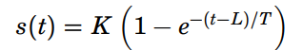
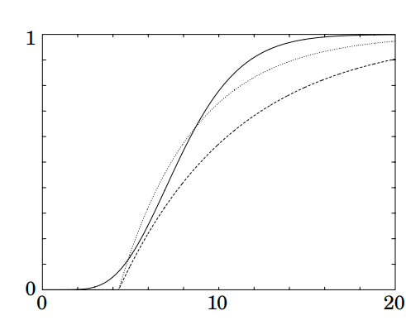
مدل سازی فرآیند- در متداول ترین حالات:
مدل سازی سه پارامتری:
The step response
Åström, Karl Johan, and Tore Hägglund. PID controllers: theory, design, and tuning. Vol. 2. Research Triangle Park, NC: Instrument society of America, 1995.

Slide 24
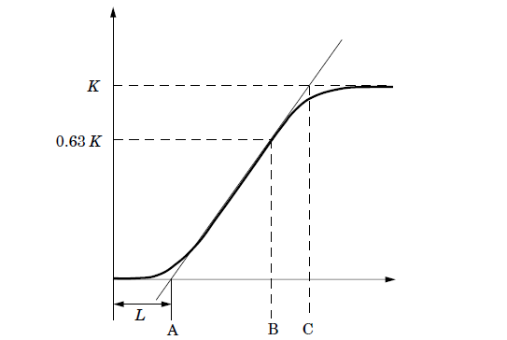
مدل سازی فرآیند- در متداول ترین حالات:
There are different ways to determine T:
One method determines T from the distance AC in Figure 2.8, where the point C is the time when the tangent intersects the line s(t) = K.
Another method determines T from the distance AB in Figure 2.8, where B is the time when the step response has reached the value 0.63K.
Both methods give identical results if the process dynamics, but they may differ significantly in other cases. The method based on the point B gives normally better approximations.
Åström, Karl Johan, and Tore Hägglund. PID controllers: theory, design, and tuning. Vol. 2. Research Triangle Park, NC: Instrument society of America, 1995.

Slide 25
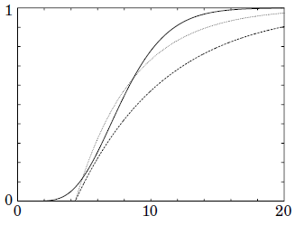
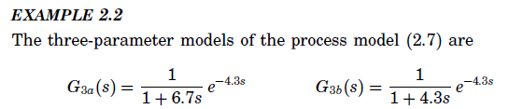

مدل سازی فرآیند- بررسی پاسخ پله فرآیند در متداول ترین حالت:
مثال:
Åström, Karl Johan, and Tore Hägglund. PID controllers: theory, design, and tuning. Vol. 2. Research Triangle Park, NC: Instrument society of America, 1995.

Slide 26
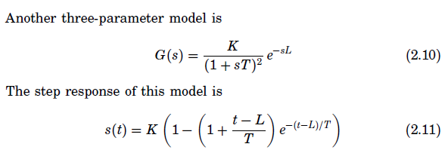
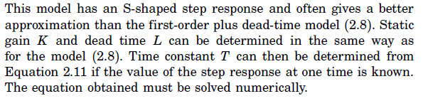
مدل سازی فرآیند- در متداول ترین حالت:
Åström, Karl Johan, and Tore Hägglund. PID controllers: theory, design, and tuning. Vol. 2. Research Triangle Park, NC: Instrument society of America, 1995.

Slide 27
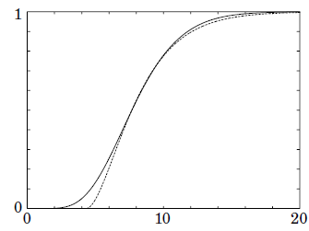
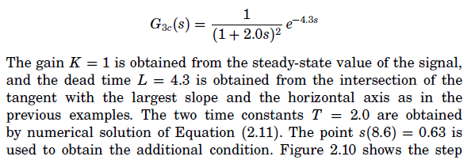
مدل سازی فرآیند- بررسی پاسخ پله فرآیند در متداول ترین حالت:
مثال:
Åström, Karl Johan, and Tore Hägglund. PID controllers: theory, design, and tuning. Vol. 2. Research Triangle Park, NC: Instrument society of America, 1995.

Slide 28
طراحی کنترولر

Slide 29
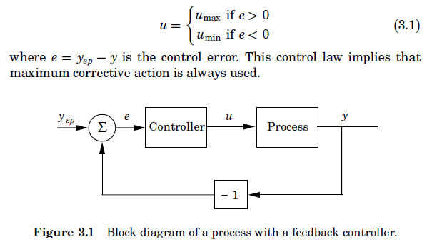
انواع کنترولر
کنترولر خاموش و روشن (On-Off controller)
Åström, Karl Johan, and Tore Hägglund. PID controllers: theory, design, and tuning. Vol. 2. Research Triangle Park, NC: Instrument society of America, 1995.

Slide 30
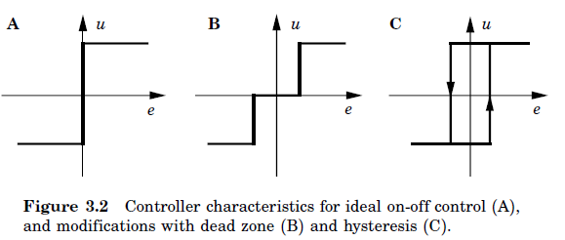
انواع کنترولر- نوع روشن- خاموش
انواع کنترل روشن- خاموش (ایده آل و توسعه یافته با ناحیه مرده و هیسترزیس)
Åström, Karl Johan, and Tore Hägglund. PID controllers: theory, design, and tuning. Vol. 2. Research Triangle Park, NC: Instrument society of America, 1995.

Slide 31
انواع کنترولر- کنترولر نوع PID
معرفی
The PID controller has several important functions:
It provides feedback;
It has the ability to eliminate steady state offsets through integral action;
It can anticipate the future through derivative action.
PID controllers are found in large numbers in all industries. The controllers come in many different forms. There are standalone systems in boxes for one or a few loops, which are manufactured by the hundred thousands yearly. PID control is an important ingredient of a distributed control system. The controllers are also embedded in many special-purpose control systems. In process control, more than 95% of the control loops are of PID type, most loops are actually PI control. Many useful features of PID control have not been widely disseminated because they have been considered trade secrets.
Åström, Karl Johan, and Tore Hägglund. PID controllers: theory, design, and tuning. Vol. 2. Research Triangle Park, NC: Instrument society of America, 1995.

Slide 32
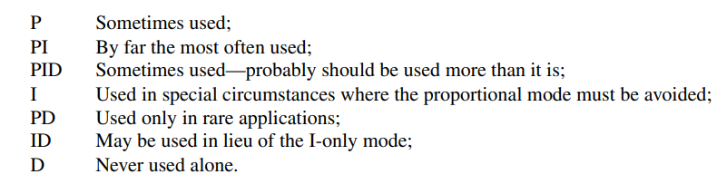
کنترولر PID
کاربردهای انواع ترکیبات P، I و D (تناسبی، انتگرالی و مشتقی)
H. L. Wade, Basic and Advanced Regulatory Control: System Design and Application, ISA (The Instrumentation, Systems, and Automation Society) 2nd Edition, 2010.

Slide 33
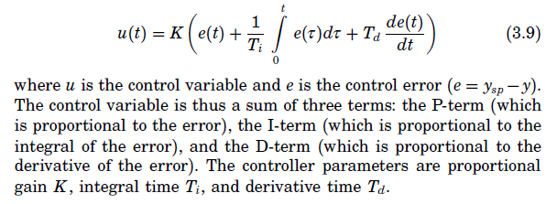
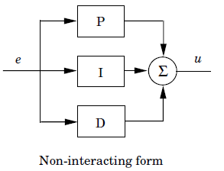
کنترولر PID
Åström, Karl Johan, and Tore Hägglund. PID controllers: theory, design, and tuning. Vol. 2. Research Triangle Park, NC: Instrument society of America, 1995.

Slide 34
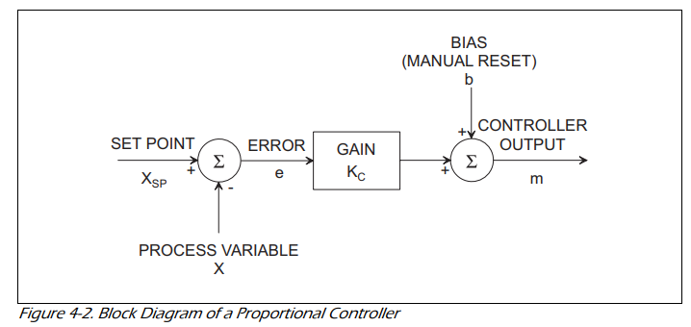
کنترولر نوع تناسبی (P)
بلوک دیاگرام کنترولر تناسبی
The bias term, b, provides the value of the controller output when the measurement and set point are equal. A very inexpensive controller might be constructed with a fixed value of b, say of 50 percent. Thus, the controller output would be 50 percent when there is no error in the loop. In most industrial-grade proportional-only controllers, the bias is adjustable; this is frequently labeled “manual reset.”
H. L. Wade, Basic and Advanced Regulatory Control: System Design and Application, ISA (The Instrumentation, Systems, and Automation Society) 2nd Edition, 2010.

Slide 35
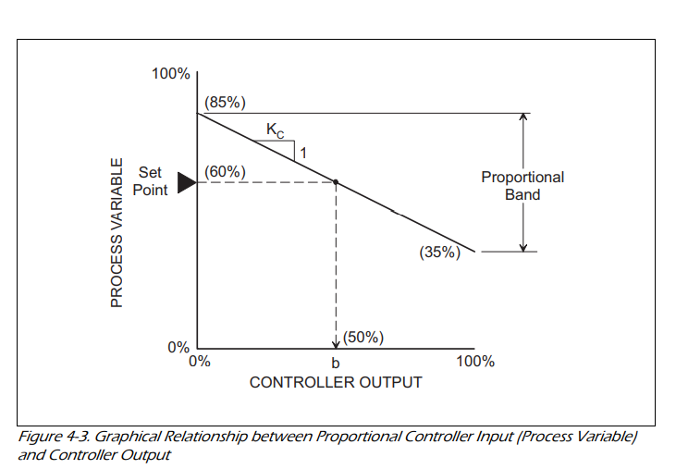
کنترولر نوع تناسبی (P)
بلوک دیاگرام کنترولر تناسبی
H. L. Wade, Basic and Advanced Regulatory Control: System Design and Application, ISA (The Instrumentation, Systems, and Automation Society) 2nd Edition, 2010.

Slide 36
کنترولر نوع تناسبی (P)
بلوک دیاگرام کنترولر تناسبی
Examine this figure and note the following:
The figure depicts a reverse-acting controller, since an increase in the process variable will cause a decrease in the controller output.
The graph in Figure 4-3 clearly indicates that when the process variable and set point are equal, the controller output is equal to the bias value.
As Figure 4-3 illustrates, if the process variable is 85 percent, the controller output will be 0 percent; if the process variable falls to 35 percent, the controller output will be 100 percent. Thus, a change in input to the controller (change in process variable) of 50 percent will cause an output change of 100 percent. The graph depicts a controller with a gain of -2.0.
H. L. Wade, Basic and Advanced Regulatory Control: System Design and Application, ISA (The Instrumentation, Systems, and Automation Society) 2nd Edition, 2010.

Slide 37
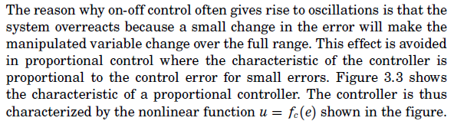
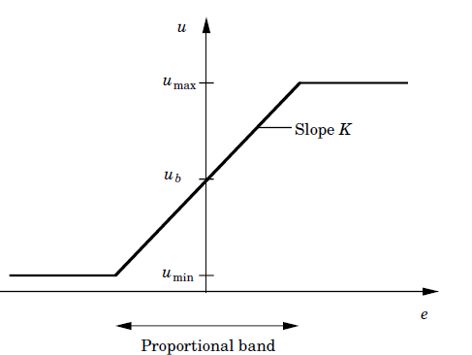
انواع کنترولر
کنترل تناسبی و مقایسه با کنترل روشن- خاموش (on/off)
Åström, Karl Johan, and Tore Hägglund. PID controllers: theory, design, and tuning. Vol. 2. Research Triangle Park, NC: Instrument society of America, 1995.

Slide 38
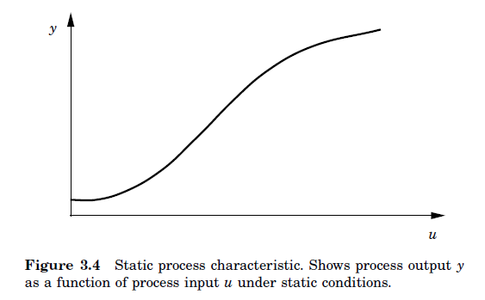
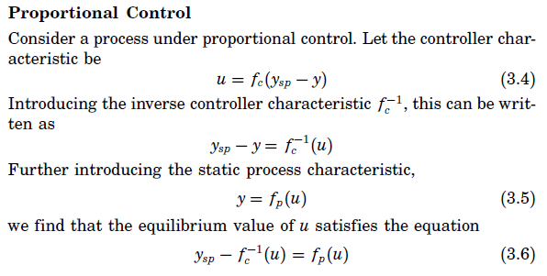
انواع کنترولر
کنترل تناسبی
Åström, Karl Johan, and Tore Hägglund. PID controllers: theory, design, and tuning. Vol. 2. Research Triangle Park, NC: Instrument society of America, 1995.

Slide 39
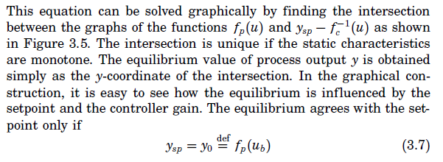
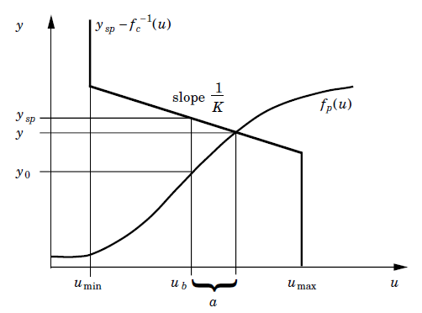
انواع کنترولر- کنترل تناسبی
Åström, Karl Johan, and Tore Hägglund. PID controllers: theory, design, and tuning. Vol. 2. Research Triangle Park, NC: Instrument society of America, 1995.

Slide 40
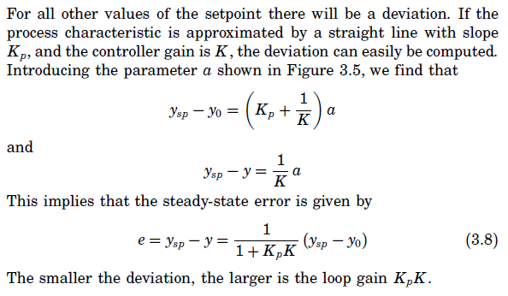
انواع کنترولر- کنترل تناسبی
Åström, Karl Johan, and Tore Hägglund. PID controllers: theory, design, and tuning. Vol. 2. Research Triangle Park, NC: Instrument society of America, 1995.

Slide 41
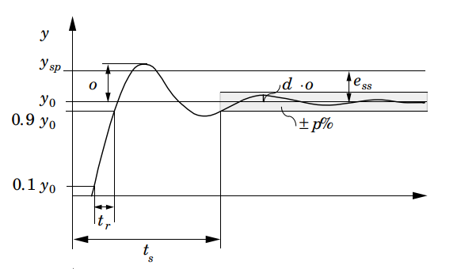
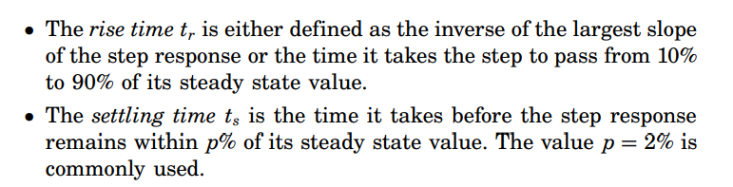
انواع کنترولر- کنترل PID
پارامترهای پاسخ پله:
Åström, Karl Johan, and Tore Hägglund. PID controllers: theory, design, and tuning. Vol. 2. Research Triangle Park, NC: Instrument society of America, 1995.

Slide 42
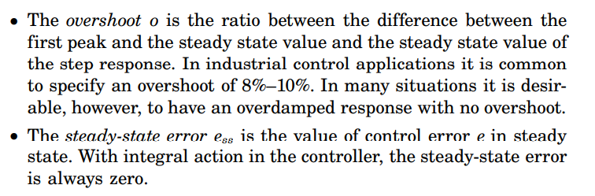
انواع کنترولر- کنترل PID
پارامترهای پاسخ پله:
Åström, Karl Johan, and Tore Hägglund. PID controllers: theory, design, and tuning. Vol. 2. Research Triangle Park, NC: Instrument society of America, 1995.

Slide 43
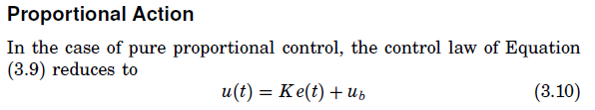


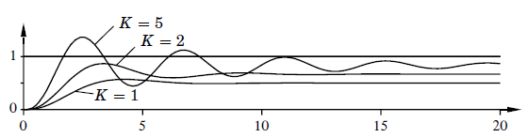

کنترل PID- اثر عملکرد تناسبی
Åström, Karl Johan, and Tore Hägglund. PID controllers: theory, design, and tuning. Vol. 2. Research Triangle Park, NC: Instrument society of America, 1995.

Slide 44

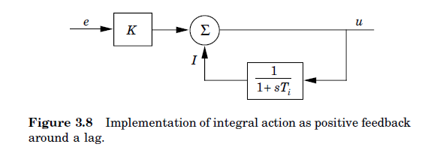
کنترل PID- عملکرد انتگرال گیر
Åström, Karl Johan, and Tore Hägglund. PID controllers: theory, design, and tuning. Vol. 2. Research Triangle Park, NC: Instrument society of America, 1995.

Slide 45
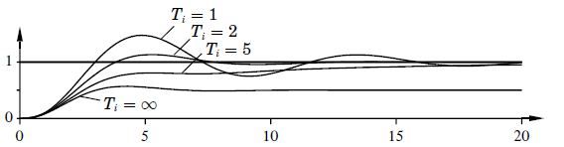

کنترل PID- عملکرد انتگرال گیر
Åström, Karl Johan, and Tore Hägglund. PID controllers: theory, design, and tuning. Vol. 2. Research Triangle Park, NC: Instrument society of America, 1995.

Slide 46
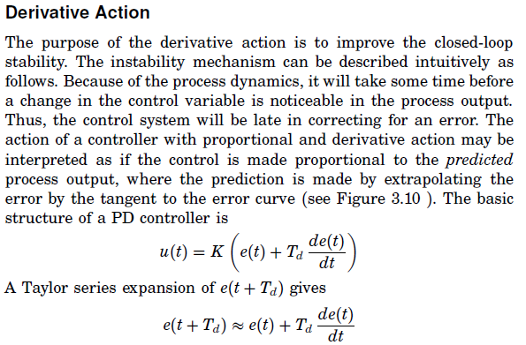
کنترل PID- عملکرد مشتق گیر
Åström, Karl Johan, and Tore Hägglund. PID controllers: theory, design, and tuning. Vol. 2. Research Triangle Park, NC: Instrument society of America, 1995.

Slide 47
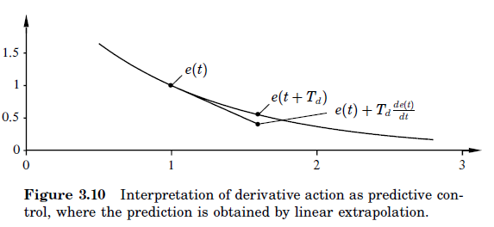


کنترل PID- عملکرد مشتق گیر
اگر Td از يک ششم پريود نوسانات بزرگ تر شود، کنترلر مشتقي ديگر مؤثر نخواهد بود.
Åström, Karl Johan, and Tore Hägglund. PID controllers: theory, design, and tuning. Vol. 2. Research Triangle Park, NC: Instrument society of America, 1995.

Slide 48



کنترل PID- تعیین ضرایب به روش زیگلر نیکولز (پاسخ پله و پاسخ فرکانسی)
1- روش پاسخ پله:
با فرض K=1
Åström, Karl Johan, and Tore Hägglund. PID controllers: theory, design, and tuning. Vol. 2. Research Triangle Park, NC: Instrument society of America, 1995.

Slide 49


کنترل PID- تعیین ضرایب به روش زیگلر نیکولز
1- روش پاسخ پله:
محاسبه ضرایب با فرض یک بودن بهره فرآیند (اگربهره یک نبود می توان پاسخ را نرمالایزه کرد)
Åström, Karl Johan, and Tore Hägglund. PID controllers: theory, design, and tuning. Vol. 2. Research Triangle Park, NC: Instrument society of America, 1995.

Slide 50


کنترل PID- تعیین ضرایب به روش زیگلر نیکولز
مثال- پاسخ:
Åström, Karl Johan, and Tore Hägglund. PID controllers: theory, design, and tuning. Vol. 2. Research Triangle Park, NC: Instrument society of America, 1995.

Slide 51

کنترل PID- تعیین ضرایب به روش زیگلر نیکولز
مثال- پاسخ:
Åström, Karl Johan, and Tore Hägglund. PID controllers: theory, design, and tuning. Vol. 2. Research Triangle Park, NC: Instrument society of America, 1995.

